Slide 1


DFV-Chogori Project A memory centric distributed transactional platform
Discussion with SAP
Seattle Cloud Lab/Cloud Storage Team
08/26/2020

Slide 2
Agenda
Chogori Project Phase I recap
Open sourced under MIT license at May, 2020
Platform for multiple modern cloud data services
Chogori Latest Development
Since last meeting (April 2020)
March towards first service – Distributed In-Memory OLTP SQL
Architecture details
Focus of today’s meeting
Would like to have opportunities to collaborate

Slide 3
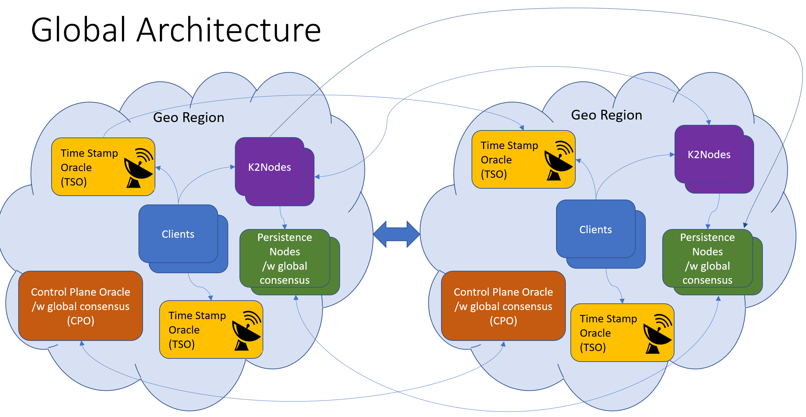
Chogori Project Phase I recap
Chogori is piloting project for next generation of cloud scale distributed data platform.
High efficient distributed transaction with strong consistency and high throughput.
Microsecond latency distributed operation with memory centric processing.
Flexible platform architecture for future multiple cloud scale services
Newly cloud DC technology is driving new efficient and cost effective system architecture.
Computing – Moore’s law, Amdahl's law -> coordination-free parallelism. SIMD, GPU, and DSA.
Networking – Faster, kernel bypass.
Storage - New memory/storage tier.
Chogori innovations (phase I)
Low latency platform – integrated network core bypass and data processing, uSec op.
K2-3SI – Sequential consistency with external causal relationship, and Serializable Snapshot Isolation level.

Slide 4
Chogori Project Phase I recap - TPC-C Perf
12 warehouses, 4 client cores, 2x4 server cores, 40GbE RDMA
New Order and Payment transaction types
12,800 txns/sec and 375,800 read or write ops/sec

Slide 5
Chogori Latest Development
Platform enhancement - SKV (Schema-aware KV)
Fundamental structured data model
versatile to support rich high-level data models (of different service, e.g. SQL, Graph, TS, etc.)
Support basic/generic operation with SKV which could help common pushdown
like Relational operator Select, Aggregation
More complex service specific pushdown operations (Still open)
e.g. join on both data inputs in the same partition, BloomFiltering pushdown for HashJoin
SQL service layer
Infrastructure
Networking/Transport
Process model (PostgreSQL)
Data model
relational -> SKV
Monolithic Database - > Partitioned Collection in Multi-tenant service
Functionality
DDL, DML
Bootstrap, reload

Slide 6
Agenda
Chogori Project Phase I recap
Open sourced under MIT license at May, 2020
Platform for multiple modern cloud data services
Chogori Latest Development
Since last meeting (April 2020)
March towards first service – Distributed In-Memory OLTP SQL
Architecture details
Focus of today’s meeting
Would like to have opportunities to collaborate

Slide 7
Network & Transport
Per-core addressability (shared nothing)
Each core polls its own RX queue and sends on its own TX queue
No cross-core dispatch
Options: DPDK w/ SR-IOV, DPDK w/ flow director, RDMA queue pairs (QPs)
App 1
App 2
Socket Dispatch
CPU 1
CPU 2
CPU 3
CPU 4
CPU 5
CPU 6
CPU 1
CPU 2
CPU 3
CPU 4
CPU 5
CPU 6
NIC QP Dispatch
NIC RSS Hash
Incoming packets
Incoming packets

Slide 8
Transaction Design Goals
Support for global transactions over datasets spanning availability zones
Scalable, multi-reader, multi-writer architecture
In-memory oriented data storage
Take advantage of low-latency network
Isolation: Serializability via Snapshot Isolation
Consistency: Sequential and External Causal Consistency
if two transactions have causal relationship even outside of our system, we guarantee that the causal relationship will be observed by all users of the system.
Our selected combination of isolation and consistency level, provides guarantee that applications will not observe any practical anomalies
K2-3SI: K2 Sequential consistency with Serializable Snapshot Isolation
An overview can be found here https://jepsen.io/consistency

Slide 9
Global Architecture
Geo Region
Geo Region
Time Stamp
Oracle
(TSO)
K2Nodes
Time Stamp
Oracle
(TSO)
K2Nodes
K2Nodes
K2Nodes
Clients
Clients
K2Nodes
K2Nodes
Persistence
Nodes
/w global
consensus
Persistence
Nodes
/w global
consensus
K2Nodes
K2Nodes
Control Plane Oracle
/w global consensus
(CPO)
Control Plane Oracle
/w global consensus
(CPO)
Time Stamp
Oracle
(TSO)
Time Stamp
Oracle
(TSO)
Notes:
This is a global architecture
Note that we have support for multiple TSO instances to achieve scalability. Clients can use timestamps from any TSO
CPO manages the service components and performs discovery, monitoring, load-balancing, etc. Instances use paxos
Persistence uses paxos

Slide 10



Maintaining immutable history with MVCC
Invariant: if a history is observed, it can no longer be modified. This extends to Global history we think of “observe” as a causal relationship
Reads on committed data always succeed
Writes are not allowed if history has been observed
In order to enforce, we use a ReadCache to remember the most-recent time at which a key has been observed
Reading/writing over a write intent requires conflict resolution
We designate a coordinator for each transactions (TRH) which is just lazily assigned to be the first write in the txn
Incoming Read
Incoming (pending) write
Attempt to modify observed history
Attempt to observe pending value
Attempt to modify pending value
1
2
3
4
5
6
7
8
9
10
11
12
13
14
time
Key history
= Read
= Committed Write
= Pending Write (Write Intent)
Notes:
Next, I would like to talk about another central idea – maintaining immutable history
To achieve this, reads allowed on committed, writes not allowed on observed, WI conflict resolution

Slide 11
Transaction overview
User Application
K2 Node
(participant)
K2 Node
(coordinator/TRH)
Persistence
K2 CPO
K2 TSO
K2ClientLib
Begin TXN
Reads
(K, txn_meta)
1st write in txn
Write
(K, V, txn_meta)
1st write designates the participant as coordinator (TRH)
Persist ()
Other writes
Write
(K, V, txn_meta)
Persist ()
Txn End (commit/abort, txn_meta)
Persist ()
Possible wait needed if
uncertainty window > txn duration
Notes:
… And the parts of a transaction: begin, reads, writes, end

Slide 12
Network cost, revisited
Name | Local DC roundtrip | Remote DC roundtrip
Percolator | ~0-10? | 8-14
TiDB | 0 | 14
Spanner | 1 | 8
YugabyteDB | 4 | 10
CockroachDB | 4 | 6
Chogori RO local (best case) | 1 | 0
Chogori R/W local | 5 (R, W, WP, C, CP) | 2 (WP, CP)
Chogori R/W remote | 2 (WP, CP) | 5 (R, W, WP, C, CP)
R: read
W: write
C: commit
CP: commit persist
WP: write persist
Most common case
Conflict detection is purely in-memory operation
Conflict outcome determination requires additional coordination/roundtrips
No additional wait needed if uncertainty window ~= network roundtrip
Sync write to disk is not necessary if we perform quorum writes to persistence.
Notes:
To revisit the network costs comparison, here is what we’ve achieved with Chogori

Slide 13
TPC-C Results
New Order and Payment transaction types
No wait time
1x4 client cores, 2x4 server cores
12 Warehouses
40Gb RDMA
9,600 transactions/second
283,000 KV read or write ops/second
p50 New Order latency: 440 usec
p99.9 New Order latency: 820 usec

Slide 14
Q&A: Thank you
Offline questions?
Google group: https://groups.google.com/forum/#!forum/chogori-dev
Source code, design documents, performance results:
https://github.com/futurewei-cloud/chogori-platform
Hao “Jerry” Feng (jerry.feng@futurewei.com)
Ivan Avramov (ivan.avramov@futurewei.com)
Justin Funston (justin.funston@futurewei.com)

